Slide 1
A Detailed Look in to Energy Consumption and Pollution Related Deaths
Presentation by PollutionSolvers - Zhongyang Hu, Hsueh-Yi Lu, Ali Can Mutlu,

Slide 2
Data Set Information -
Data Sets taken from Kaggle
Main features: Nitrogen, GDP, Death per 100,000 people, Indoor Air Pollution, Outdoor Ozone Pollution, Outdoor Particulate Matter

Slide 3
Dataset Summary
data_health: 2.12_Health_systems.csv
Source: Kaggle
Variables:
Country_Region: Qualitative,Categorical Completeness_of_birth_reg_2009-18: Numerical,Continuous
World_Bank_Name : Qualitative,Categorical per_capita_exp_PPP_2016: Numerical,Continuous
Health_exp_pct_GDP_2016 : Numerical,Continuous External_health_exp_pct_2016: Numerical,Continuous
Health_exp_public_pct_2016 : Numerical,Continuous Physicians_per_1000_2009-18: Numerical,Continuous
Health_exp_out_of_pocket_pct_2016 : Numerical,Continuous Nurse_midwife_per_1000_2009-18: Numerical,Continuous
Health_exp_per_capita_USD_2016 : Numerical,Continuous Specialist_surgical_per_1000_2008-18: Numerical,Continuous

Slide 4
Dataset Summary
data_clean: cleanFuelAndTech.csv
Source: Kaggle
Variables:
Location: Qualitative,Categorical
Indicator: Qualitative,Categorical
Period: Numerical, Categorical
First Tooltip: Numerical,Continuous

Slide 5
Dataset Summary
data_pollution: death-rates-from-air-pollution.csv
Source: Kaggle
Variables:
Entity: Qualitative,Categorical
Code: Qualitative,Categorical
Year: Numerical, Categorical
Air pollution (total) (deaths per 100,000): Numerical,Continuous
Indoor air pollution (deaths per 100,000):Numerical,Continuous
Outdoor particulate matter (deaths per 100,000):Numerical,Continuous
Outdoor ozone pollution (deaths per 100,000):Numerical,Continuous

Slide 6
Dataset Summary
data_GDP: Country_wise_GDP_from_1994_to_2017.csv
Source: Kaggle
Variables:
Country: Qualitative,Categorical Population: Numerical,Continuous
Year: Numerical, Categorical Pop. change (%): Numerical,Continuous
GDP (in USD): Numerical,Continuous GDP Real (in USD):Numerical,Continuous
GDP change (%):Numerical,Continuous
GDP per capita (in USD):Numerical,Continuous

Slide 7
Dataset Summary
data_energy: Percentage_of_Energy_Consumption_by_Country.csv
Source: Kaggle
Variables:
Country: Qualitative,Categorical Hydro Generation – TWh:Numerical,Continuous
Code: Qualitative,Categorical Nuclear Generation – TWh: Numerical,Continuous
Year: Numerical, Categorical Solar Generation – TWh: Numerical,Continuous
Coal Consumption - EJ :Numerical,Continuous Wind Generation –TWh: Numerical,Continuous
Gas Consumption - EJ Numerical,Continuous Oil Consumption – EJ: Numerical,Continuous
Geo Biomass Other - TWh :Numerical,Continuous

Slide 8
Data Pre-Processing
class preprocessing():
def indoor2016(self): df1=self.dfselection(self.setf2,self.data_health,'World_Bank_Name') df2=self.dfselection(self.setf2,self.data_clean,'Location') df3=self.dfselection(self.setf2,self.data_pollution,'Entity') df4=self.dfselection(self.setf2,self.data_GDP,'Country') df2=df2[df2['Period']==2016] df3=df3[df3['Year']==2016] df4=df4[df4['Year']==2016] df1=df1.rename(columns={"World_Bank_Name": "Location"}) df3=df3.rename(columns={'Entity':'Location'}) df4=df4.rename(columns={'Country':'Location'}) out=pd.merge(df1,df2,how='outer',on='Location') out=pd.merge(out,df3,how='outer',on="Location") out=pd.merge(out,df4,how='outer',on='Location') out=out.drop(columns='Province_State') return out
Indoor2016():
Select datasets
Year = 2016
Rename columns
Merge datasets

Slide 9
Data Pre-Processing
indoor():
Select datasets
Rename columns
Merge datasets by Location and Year
def indoor(self): df2=self.dfselection(self.setf2,self.data_clean,'Location') df3=self.dfselection(self.setf2,self.data_pollution,'Entity') df4=self.dfselection(self.setf2,self.data_GDP,'Country') df2 = df2.rename(columns={"Period": "Year"}) df3 = df3.rename(columns={'Entity': 'Location'}) df4 = df4.rename(columns={'Country': 'Location'}) out = pd.merge(df2, df3, how='outer', on=['Location','Year']) out = pd.merge(out, df4, how='outer', on=['Location','Year']) return out

Slide 10
Data Pre-Processing
Outdoor():
Select datasets
Rename columns
Merge datasets by Location and Year
def outdoor(self): df3=self.dfselection(self.setf,self.data_pollution,'Entity') df4=self.dfselection(self.setf,self.data_GDP,'Country') df3 = df3.rename(columns={'Entity': 'Location'}) df4 = df4.rename(columns={'Country': 'Location'}) out = pd.merge(df3, df4, how='outer', on=['Location', 'Year']) return out

Slide 11
Data Pre-Processing
def Merge_energy(self): df5 = self.dfselection(self.setf2, self.data_energy, 'Entity') df3 = self.dfselection(self.setf2, self.data_pollution, 'Entity') df4 = self.dfselection(self.setf2, self.data_GDP, 'Country') df3 = df3.rename(columns={'Entity': 'Location'}) df4 = df4.rename(columns={'Country': 'Location'}) df5 = df5.rename(columns={'Entity': 'Location'}) out = pd.merge(df5, df3, how='outer', on=['Location', 'Year']) out = pd.merge(out, df4, how='outer', on=['Location', 'Year']) out = out.drop(columns='Wind Generation -TWh') out = out.drop(columns='Solar Generation - TWh') out = out.drop(columns='Nuclear Generation - TWh') out = out.drop(columns='Hydro Generation - TWh') out = out.drop(columns='Geo Biomass Other - TWh') out = out.drop(columns='Gas Consumption - EJ') return out
Merge_energy():
Select datasets
Rename datasets
Merge datasets
Drop unnecessary columns

Slide 12
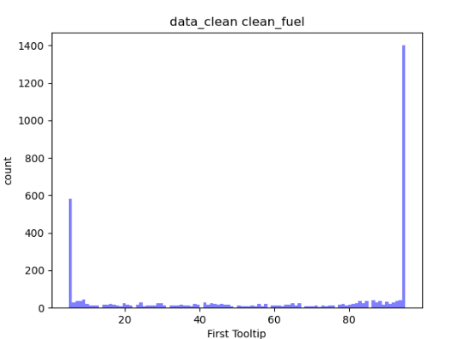
EDA
dc = data_clean_p num_bins = 100 # the histogram of the data n, bins, patches = plt.hist(dc['First Tooltip'], num_bins, facecolor='blue', alpha=0.5) plt.xlabel('First Tooltip') plt.ylabel('count') plt.title('data_clean clean_fuel’) plt.show()

Slide 13
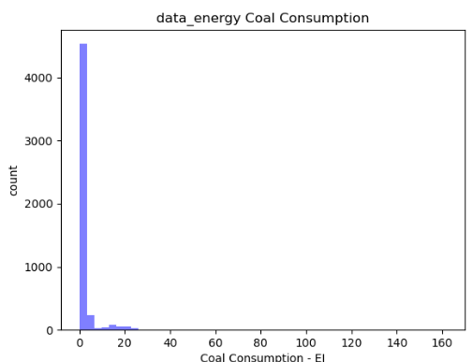
EDA
de = data_energy_p num_bins = 50 n, bins, patches = plt.hist(de['Coal Consumption - EJ'], num_bins, facecolor='blue', alpha=0.5) plt.xlabel('Coal Consumption - EJ') plt.ylabel('count') plt.title('data_energy Coal Consumption') plt.show()

Slide 14
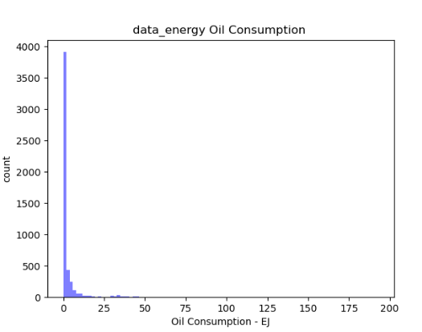
EDA
num_bins = 100 n, bins, patches = plt.hist(de['Oil Consumption - EJ'], num_bins, facecolor='blue', alpha=0.5) plt.xlabel('Oil Consumption - EJ') plt.ylabel('count') plt.title('data_energy Oil Consumption') plt.show()

Slide 15
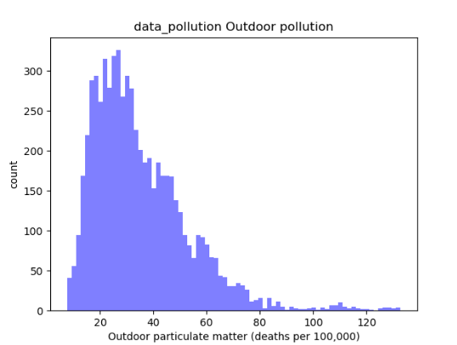
EDA
dp = data_pollution_p num_bins = 75 n, bins, patches = plt.hist(dp['Outdoor particulate matter (deaths per 100,000)'], num_bins, facecolor='blue', alpha=0.5) plt.xlabel('Outdoor particulate matter (deaths per 100,000)') plt.ylabel('count') plt.title('data_pollution Outdoor pollution') plt.show()

Slide 16
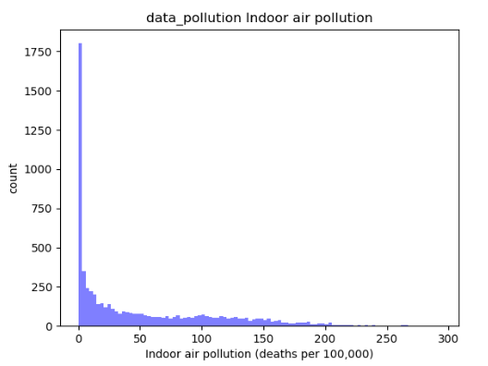
EDA
num_bins = 100 n, bins, patches = plt.hist(dp['Indoor air pollution (deaths per 100,000)'], num_bins, facecolor='blue', alpha=0.5) plt.xlabel('Indoor air pollution (deaths per 100,000)') plt.ylabel('count') plt.title('data_pollution Indoor air pollution') plt.show()

Slide 17
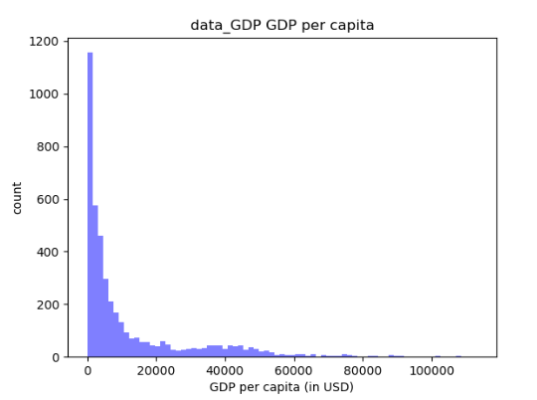
EDA
dg = data_GDP_p num_bins = 75 n, bins, patches = plt.hist(dg['GDP per capita (in USD)'], num_bins, facecolor='blue', alpha=0.5) plt.xlabel('GDP per capita (in USD)') plt.ylabel('count') plt.title('data_GDP GDP per capita') plt.show()

Slide 18
Introduction of the Model

Slide 19
Evaluation of the Correlation

Slide 20
Findings – Basic Model

Slide 21
Transform of Data

Slide 22
Generating Data Features

Slide 23
Accuracy Result

Slide 24
Residual Result

Slide 25
GUI GRAPHS DISPLAY

Slide 26
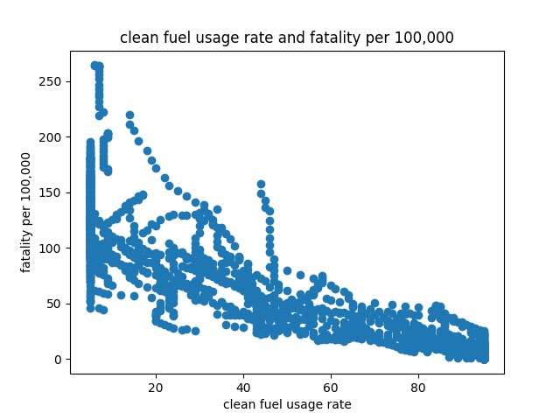


Slide 27
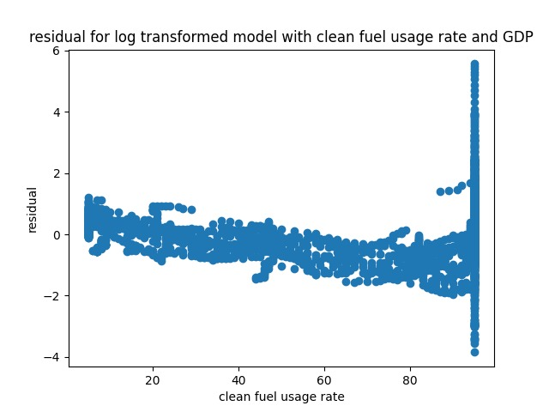

Slide 28
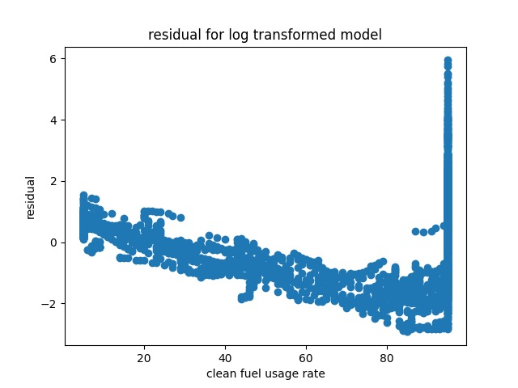

Slide 29
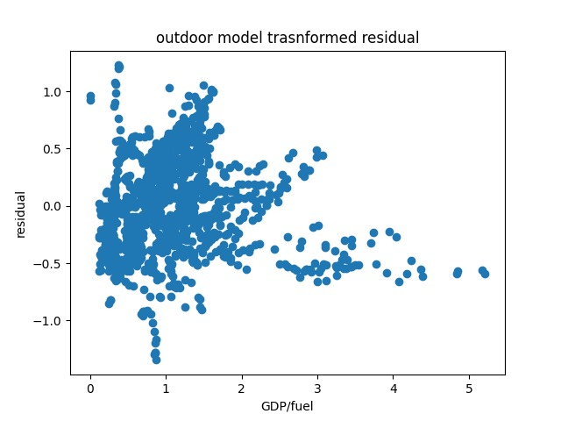

Slide 30
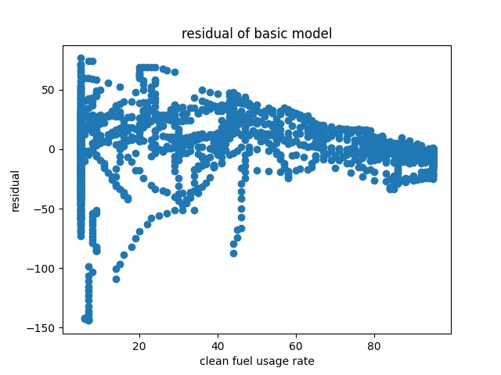

Slide 31
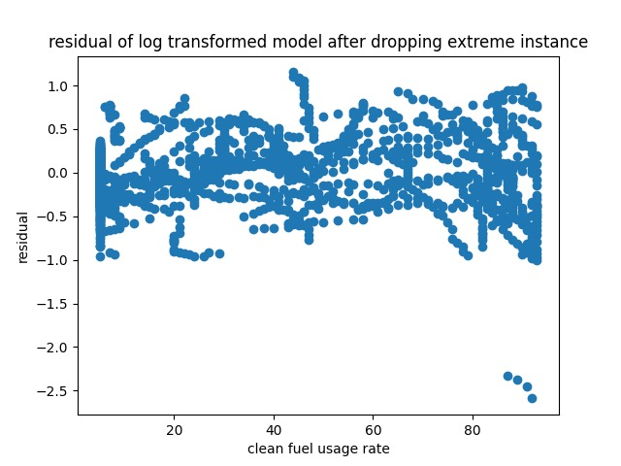

Slide 32
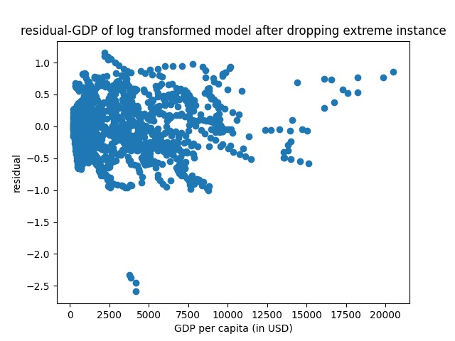

Slide 33
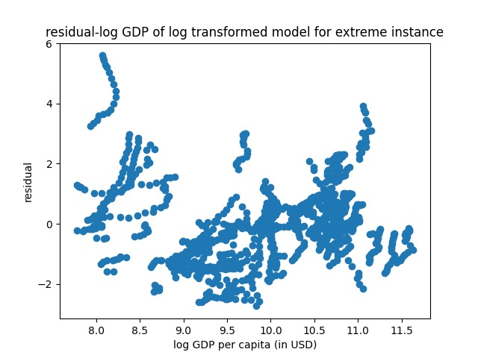

Slide 34
References

Slide 35
What Next?

